Slide 1
What political party do you belong to?
Becky Rozansky

Slide 2
Who needs the two party system anyway?
While America has historically always been a two party system, third parties have always been around. Three main ones are:
The Green Party
The Libertarian Party
The Constitutionalist Party

Slide 3
The Green Party
Very liberal
Pro-environment
Pro-choice
Support more regulation on big business
Favor gun control

Slide 4
The Libertarian Party
Conservative, but typically more socially liberal than Republican conservatives
Pro choice
Anti - Gun control
Anti pro environment legislation
Support an unregulated economy

Slide 5
The Constitutionalist Party
VERY conservative
Pro life
Anti gun control
Anti government environmental regulation
Support regulation of large corporations

Slide 6
The Questions I Asked
Do individuals have a right to abortion?
Should the government participate in environmental restoration/protection?
Should the government enforce stronger regulations of big corporations?
Should we have stronger gun control?

Slide 7

The Dataset

Slide 8
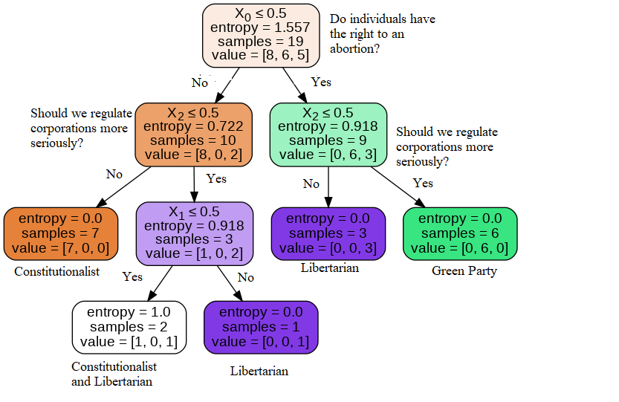

Slide 9
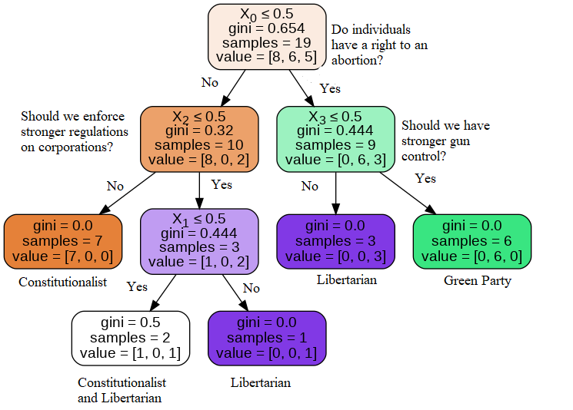

Slide 10
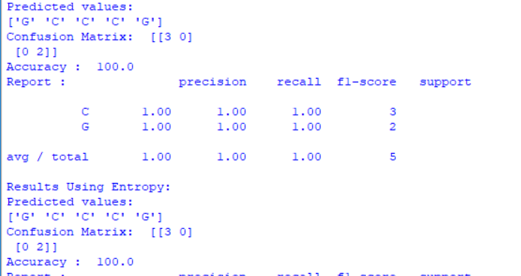

Accuracy

